Slide 1
A Very Merry
Critters’ Christmas
by David R Morgan
Phone 440-241-3126
Email : sizemore3630@aol.com

Slide 2
A Very Merry Critters’ Christmas is a tale like none ever told. This heartwarming family story is about all the little critters who know the true meaning of Christmas and they want to celebrate too!
From ladybugs to honey bees and moths and more, all the critters decorate their homes, drink eggnog, recreate the Nativity, and give gifts from their hearts to celebrate the Greatest Gift given to all of us and to the Creation themselves.
Come, join the fun as we see all the critters created by the same One who created you and me!

Slide 3
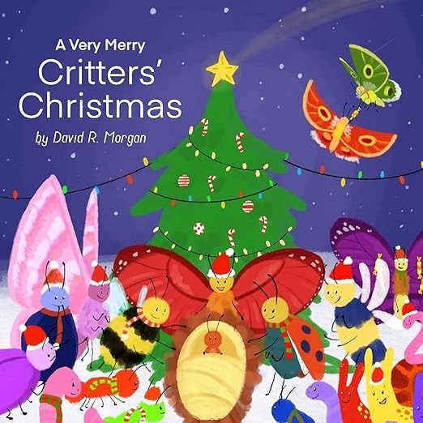
A Very Merry Critters’ Christmas is a story for the whole family. It is filled with adventure and fun and meaning and more!

Slide 4
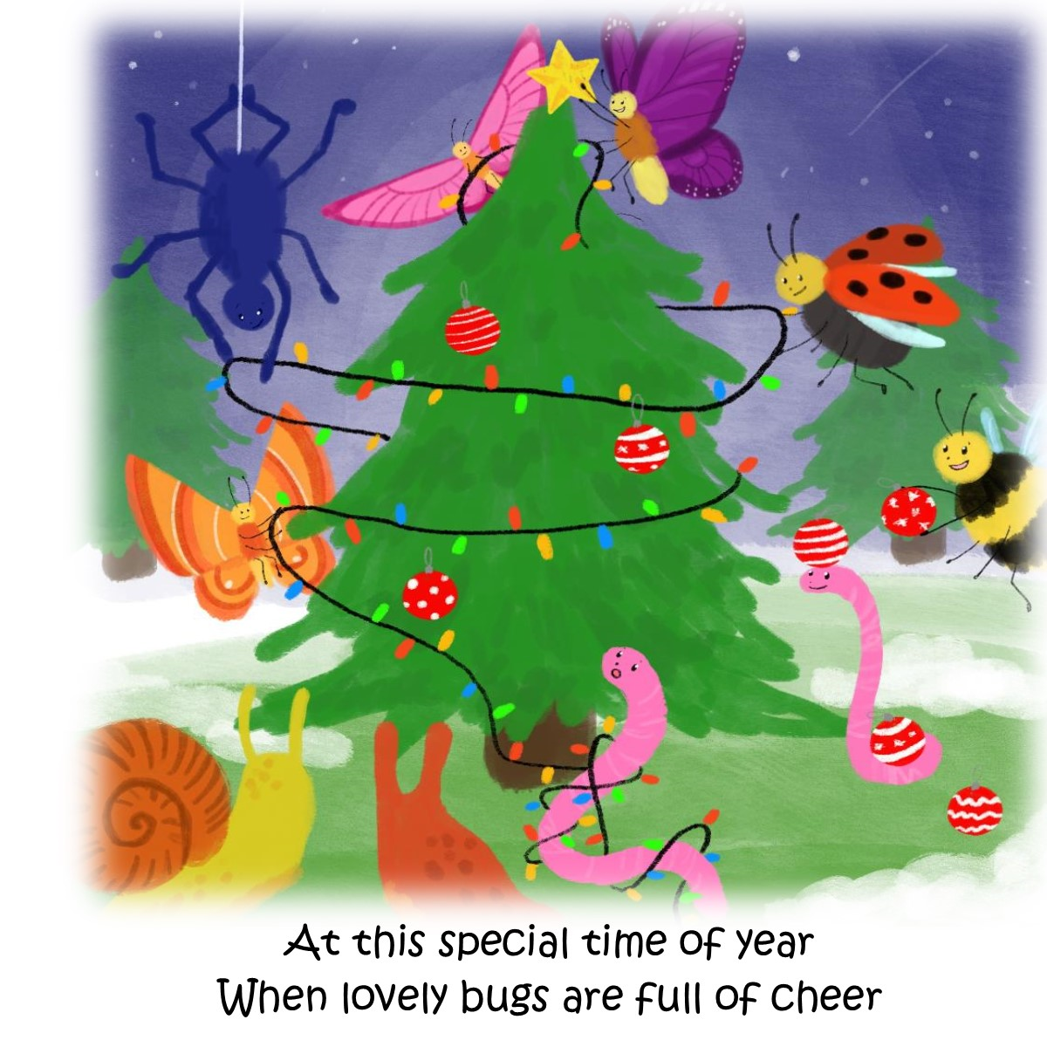
The LOOK and FEEL of
the story is warm and
happy and engages
not only the young viewer, but the whole family. The story is Christian faith-based and has a message of Creation celebrating the true meaning of Christmas – a message that will
never be lost.

Slide 5
CHARACTERS

Slide 6
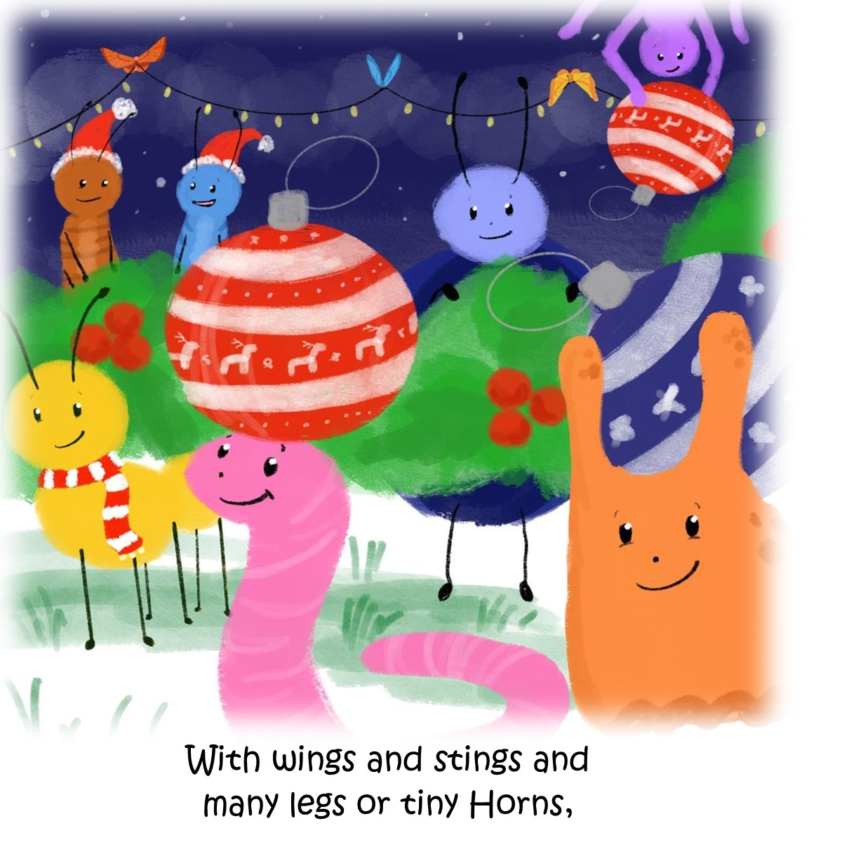
All sorts of Critters
All different critters are celebrating the holidays in this fun and zany little book about Christmas and the New Born Babe

Slide 7
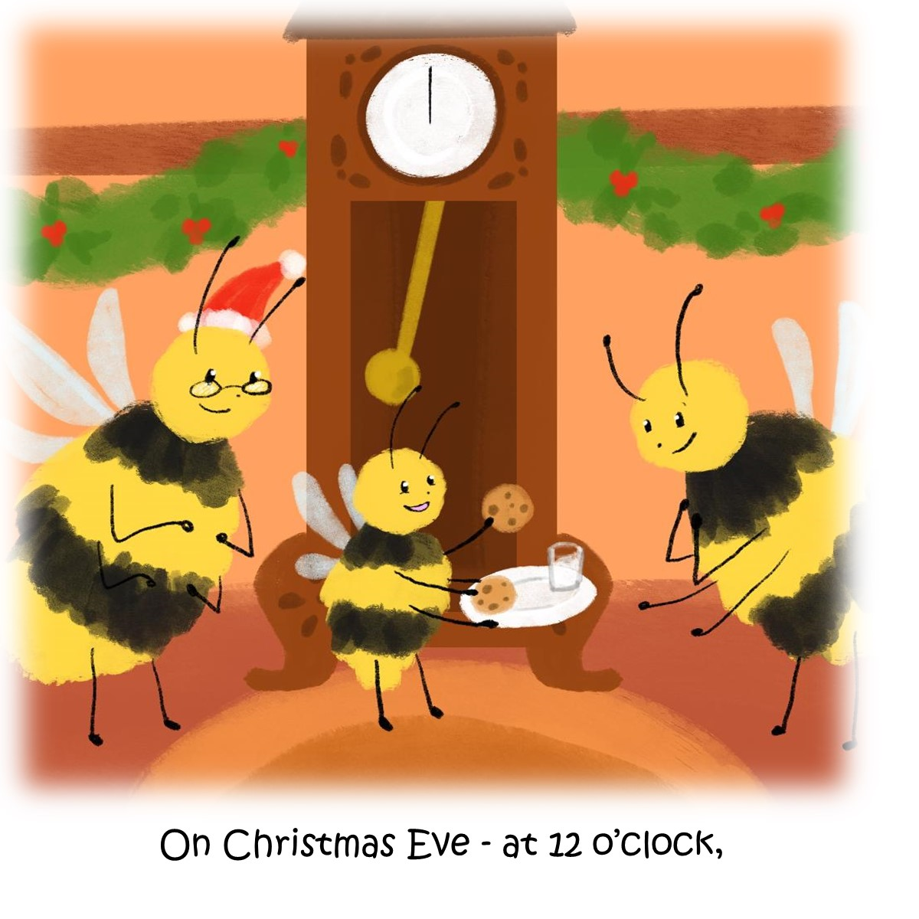
Even Bumblebees
All are getting ready for the Wonderful Event – all Creation knows how special Christmas is.

Slide 8
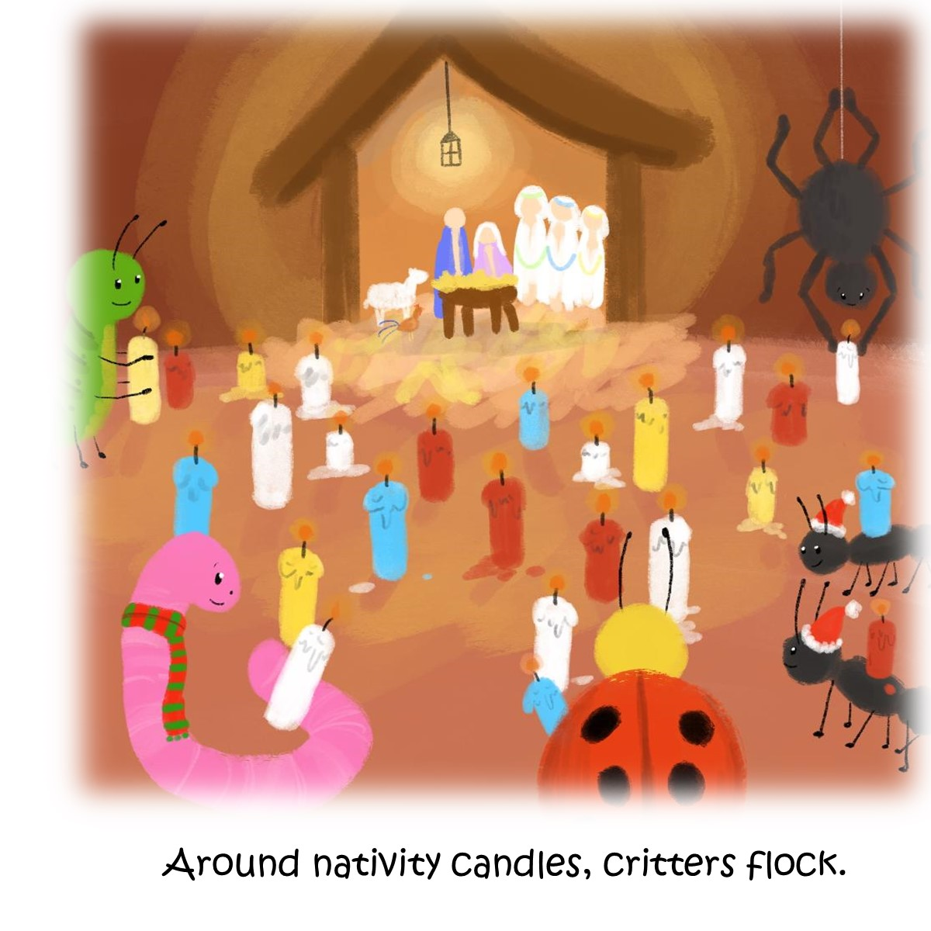
They all
Come to celebrate around the Nativity and bring candles…

Slide 9
Sample Scenes Are :

Slide 10
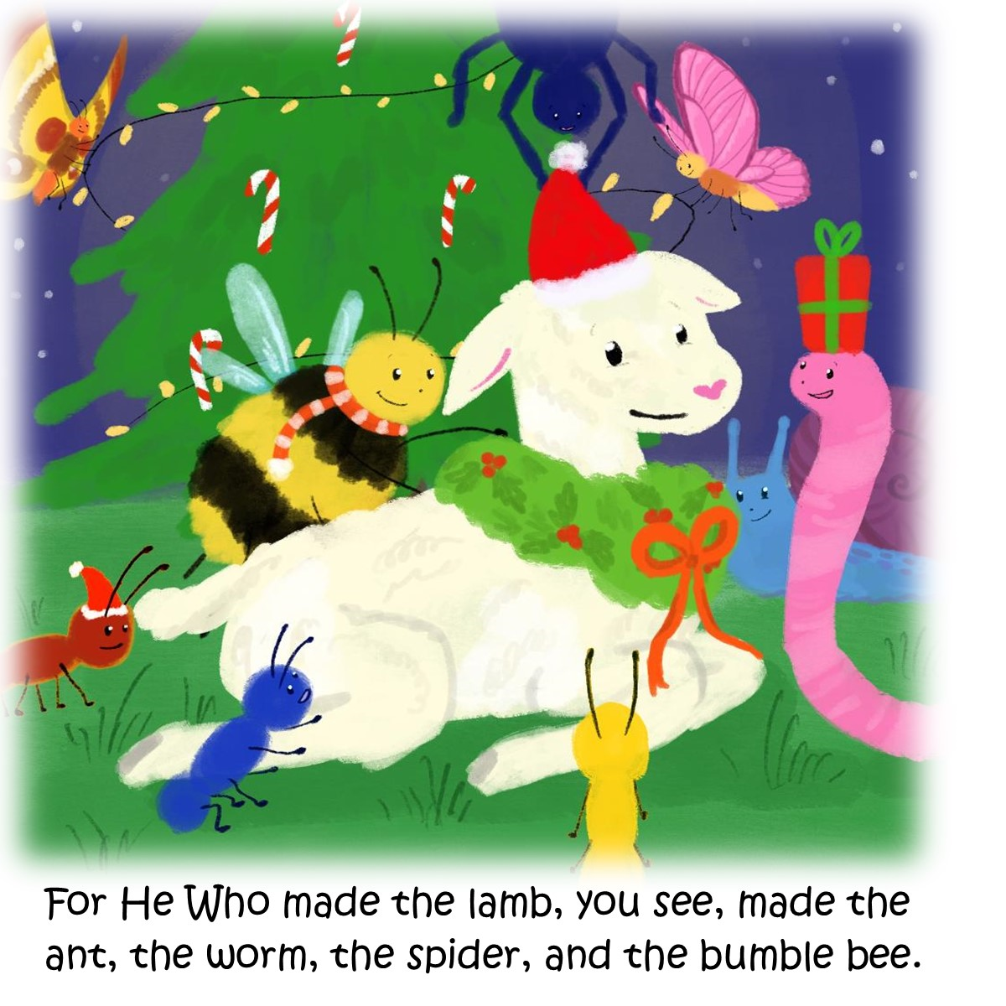
Creation of all kinds are celebrating

Slide 11
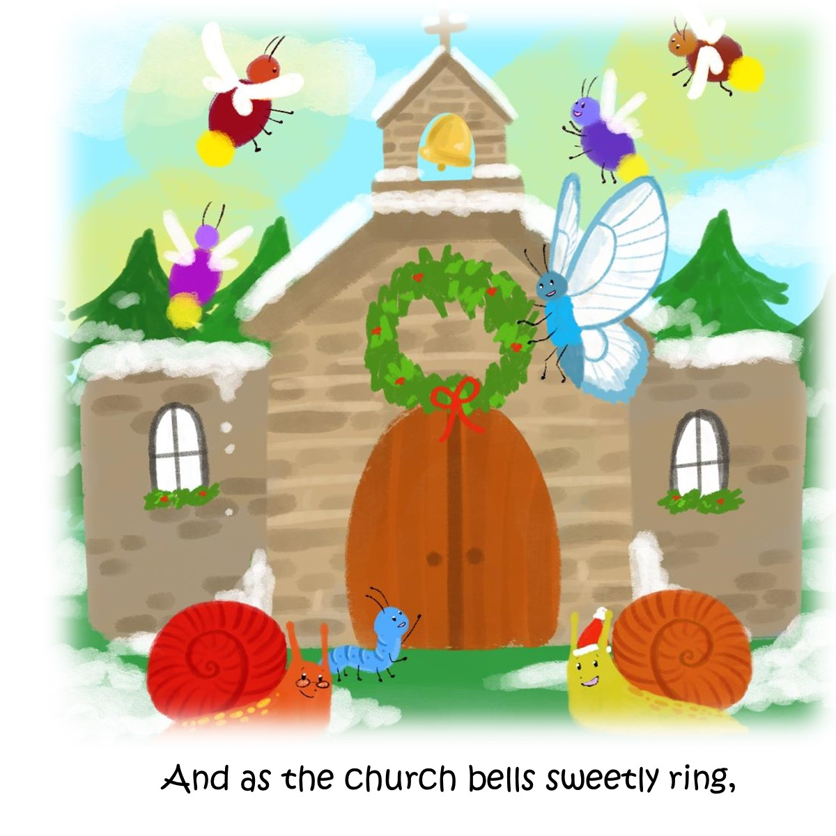
Church is where they go as well

Slide 12
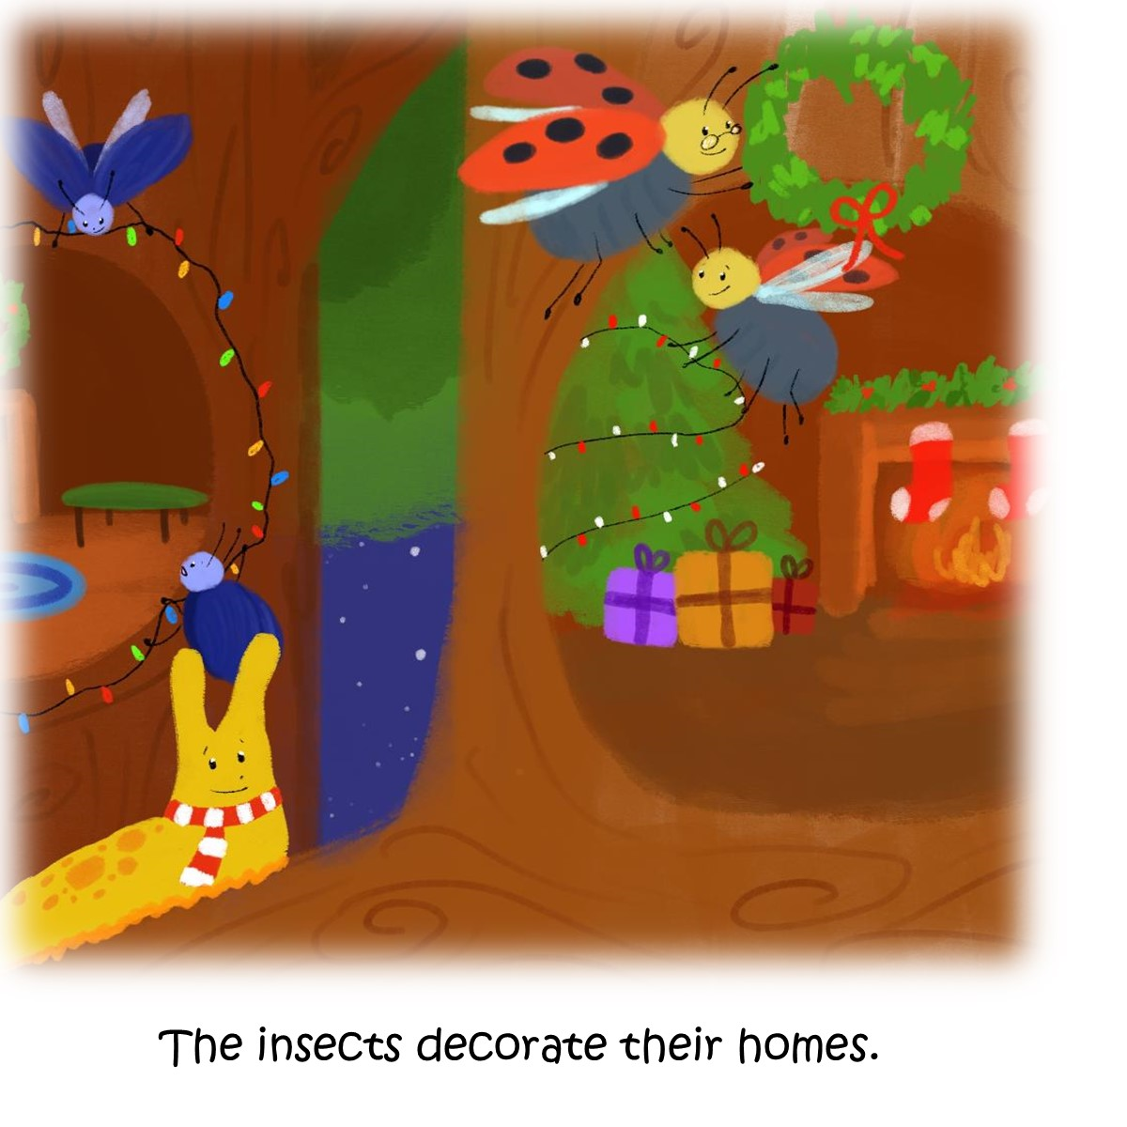
And they have so much fun decorating too

Slide 13
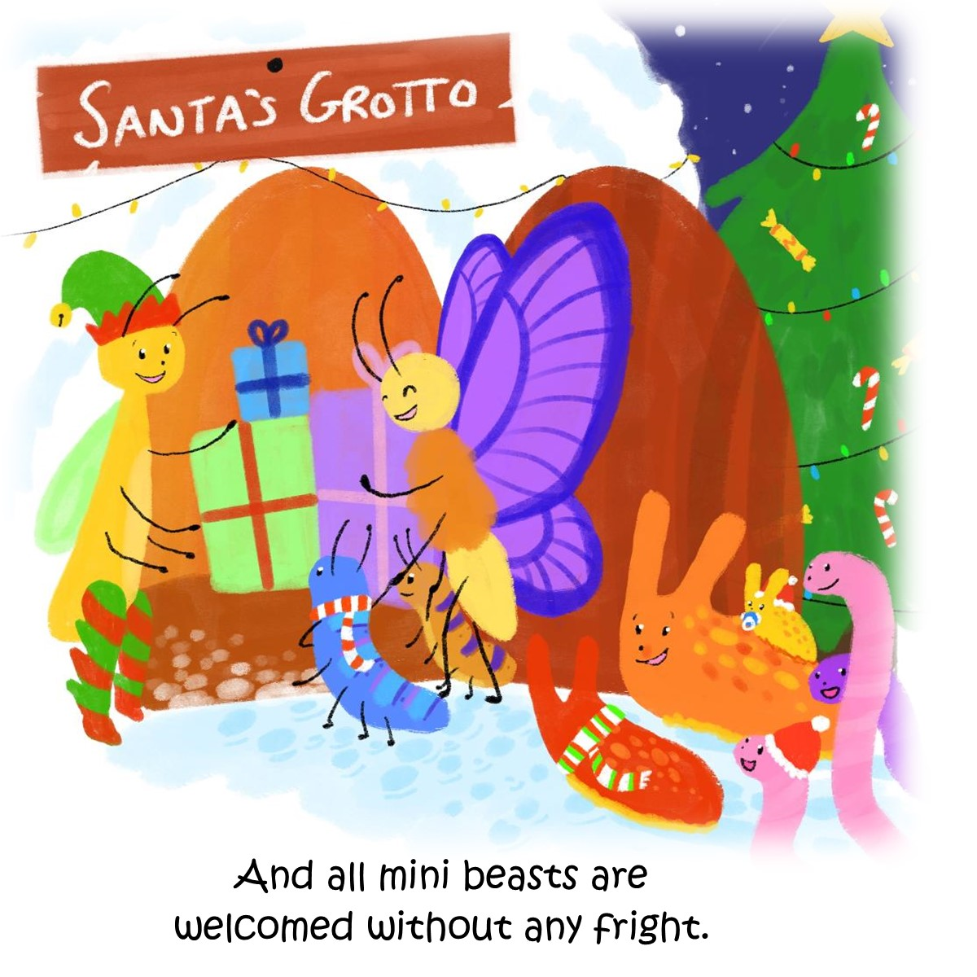
And giving gifts

Slide 14
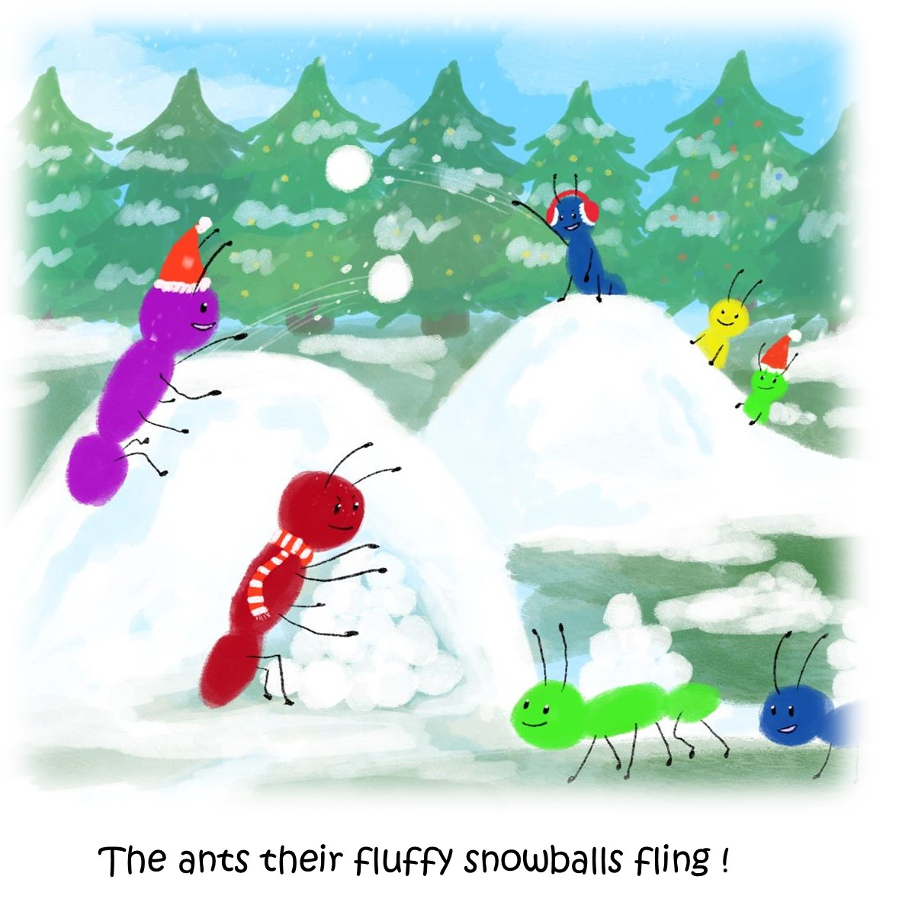
Fun in the snow

Slide 15
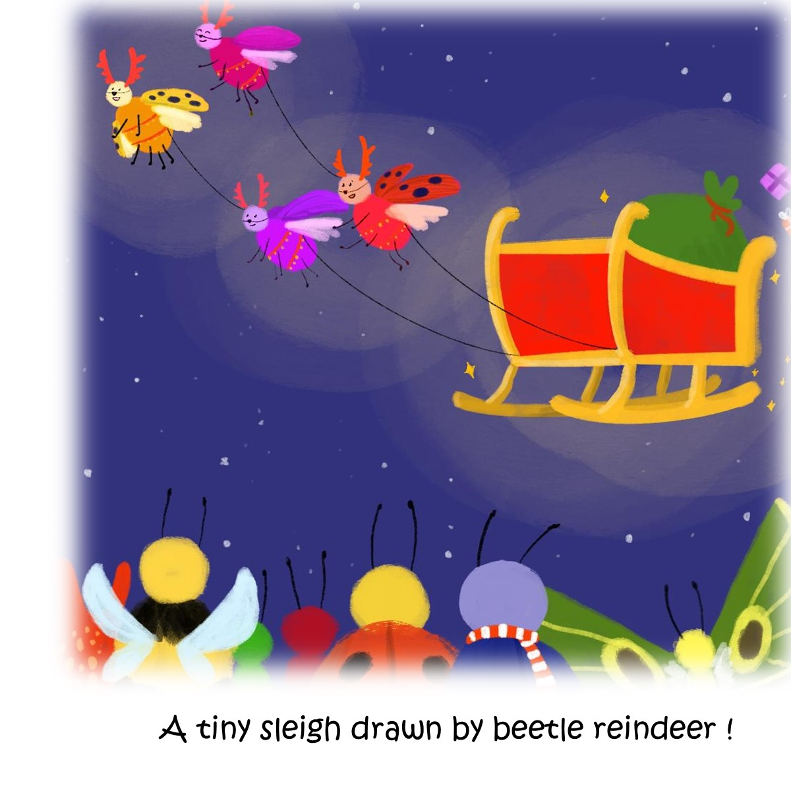
Waiting for Santa

Slide 16
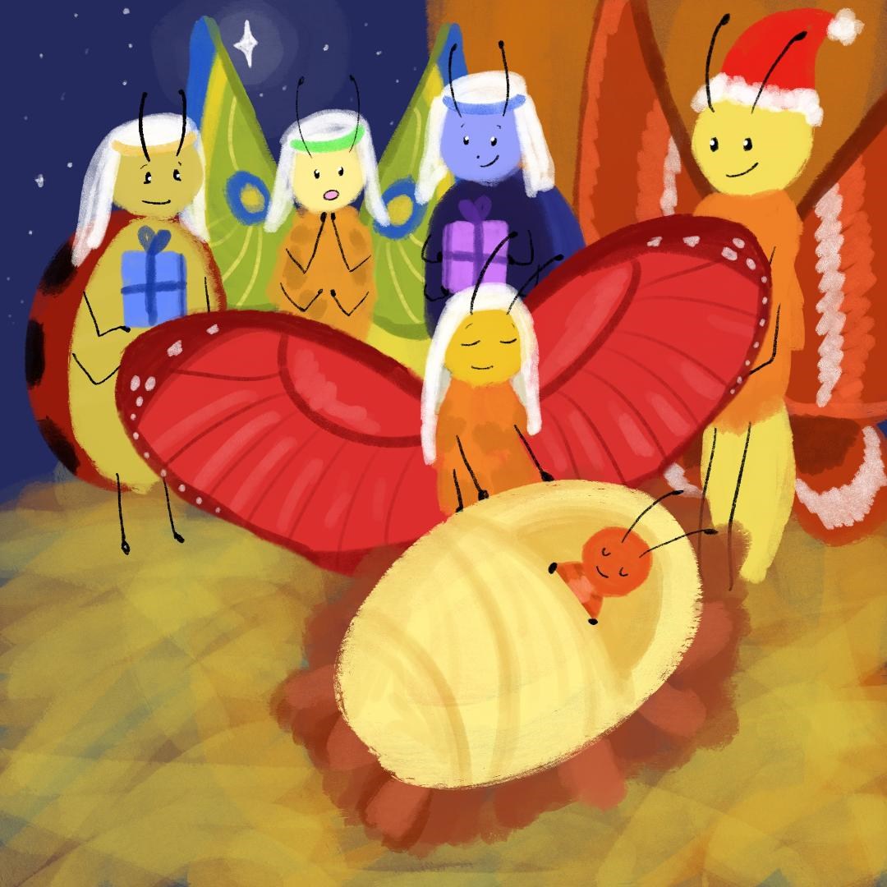
How is A Very Merry Critters’ Christmas different from others?
A Very Merry Critters’ Christmas is not only a story about the critters celebrating Christmas, but about these critters celebrating the New Born King at Christmas!
It is zany story with critter images, but the Christmas story!

Slide 17
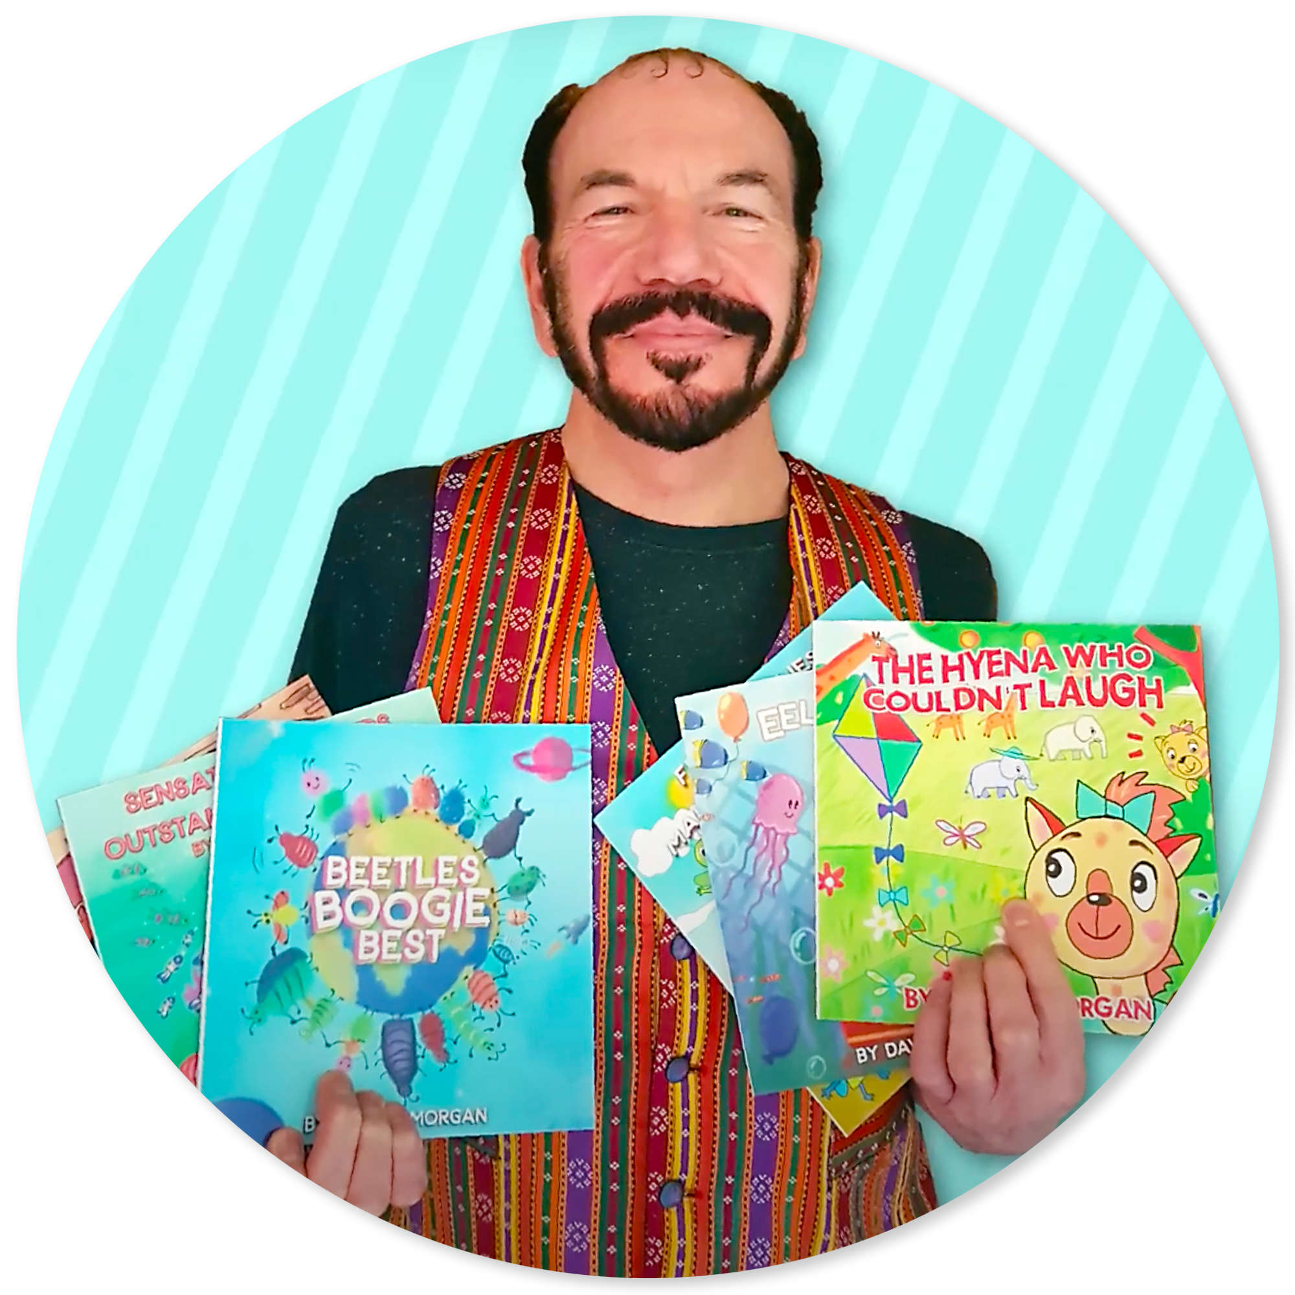
David R Morgan lives in England. He is a talented full-time teacher and award-winner author.
He has written music journalism, poetry and children’s books. David created A Very Merry Critters’ Christmas for the young reader to not only enjoy learning to read, but Critters’ Christmas is filled with colorful and darling illustrations to engage the young reader.

